Slide 1
Backend Engineering Project
Campus-Gig
Team Details: Sneha(2310990975)
Tanisha (2310990982)
Titiksha(2310990988)
Vanshika(2310990995)
Faculty Coordinator: Mr Vikas Kumar
:
Chitkara University Institute of Engineering and Technology,
Chitkara University, Punjab

Slide 2
Table of Contents
Introduction
Problem Statement
Technical Details
Key Features
Project Highlights
Future enhancements
Conclusion
References/Links used

Slide 3
INTRODUCTION
CampusGig is a web application and platform developed to facilitate seamless connections between students and the campus community for gigs, tasks, events, and various services.
It comprises a frontend and backend built with modern web technologies such as React, Node.js, Express, etc. Ensuring a fast, responsive, and intuitive user experience across devices.
The goal is to enable students to post, search, and apply for campus-based gigs, fostering opportunities for skill utilization, collaboration, and timely completion of tasks, thereby bridging the gap between demand and supply within the campus.
It serves as a campus micro-marketplace, enhancing trust and visibility through profiles, reviews, and feedback, creating a reliable ecosystem for all users.

Slide 4
PROBLEM STATEMENT
Many students face difficulties finding small paid jobs or gigs within or around their campus, particularly those that fit their schedules or align with their skills and interests.
Existing freelancing platforms are often too broad, highly competitive, and not tailored for micro-tasks or campus-specific opportunities.
Local campus organizations, clubs, and small businesses also have short-term tasks or gigs but lack an efficient way to post, manage, or access reliable and trustworthy labor.
There is a clear gap in connecting demand and supply: ensuring that tasks are matched with suitable students in real-time, while addressing challenges like trust, scheduling, payments, and reputation management.

Slide 5
TECHNICAL DETAILS
Architecture & Components
Frontend: React for UI, dashboards, forms, gig listing, chat, and notifications (react-hot-toast).
Backend: Node.js + Express REST API for user auth, gigs, messaging, and payments.
Database: MongoDB (NoSQL) for storing users, gigs, applications, reviews, and transactions.
Authentication/Authorization: JWT-based login with role-based access for students and service providers.
Real-Time Features: Socket.IO for notifications and messaging.
File Handling: Multer for uploads; Nodemailer for email notifications.
Payments: Razorpay integration for secure transactions.

Slide 6
TECHNICAL DETAILS
CRUD APIs:
Gigs: Create, update, delete, and view gigs.
User Profiles: Manage student and service provider profiles.
Applications: Handle gig applications, including accept/reject actions.

Slide 7
KEY FEATURES
Gig Posting & Browsing — Students can post gigs with details (title, description, pay, time, location). Others can search and filter.
User Profiles & Verification — Students have profiles, with optional verification or identity confirmation to build trust.
Application & Bidding — Students can apply for gigs, and poster can accept or reject applications.
Built-in Chat System — Real-time messaging between the gig poster and client, including text , voice notes, and video calls.
Secure Payments — Integrated payment system for safe transactions between gig posters and applicants.

Slide 8
KEY FEATURES
Notifications & Emails — Instant alerts for gig applications, accept/reject updates, chat messages, and gig progress. Optional email notifications for posting gigs, application acceptance, or gig completion.
Ratings & Review System — After completion, both sides can give feedback to maintain quality.
Search & Filters — Search gigs by skill name and filter according to gig status (applied, accepted, completed).
Activity Timeline — A complete timeline showing posted gigs, accepted gigs, and completed gigs.

Slide 9
PROJECT HIGHLIGHTS
Campus-Specific Focus: Tailored for on-campus tasks, considering distance, scheduling, and student convenience.
Micro-Task Friendly: Supports smaller, manageable tasks that fit student schedules.
User Trust & Ratings: Scalable reputation system with reviews and feedback for reliability.
End-to-End Full Stack Implementation: Fully functional frontend and backend integrated seamlessly.
Scalable Architecture: Modular code with clean separation of concerns, making it easy to extend.
Real-World Adoption Potential: Designed for immediate use and utility within colleges or universities.

Slide 10
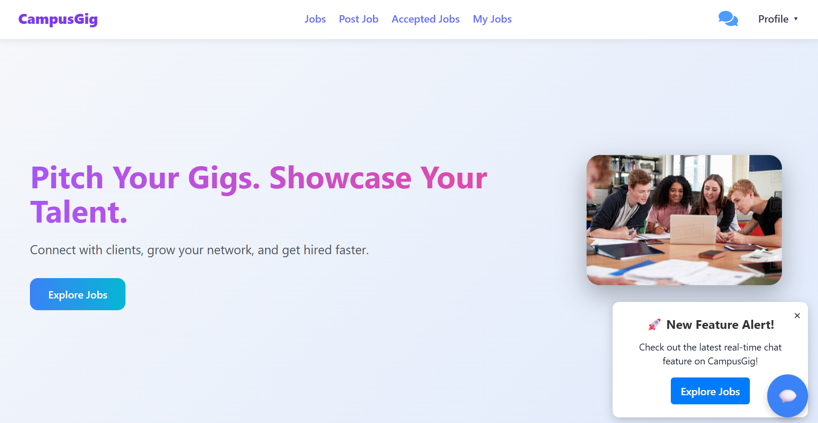
Landing Page

Slide 11
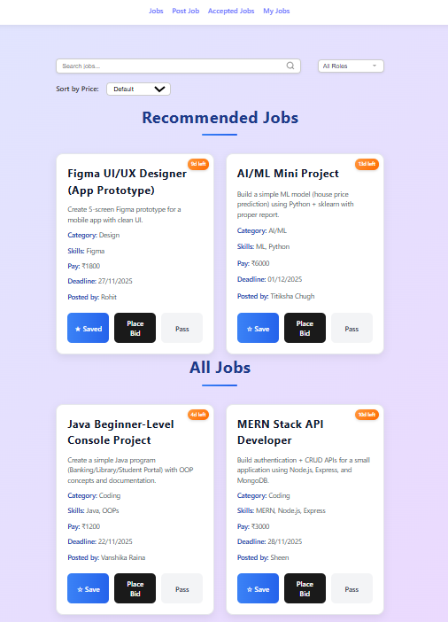
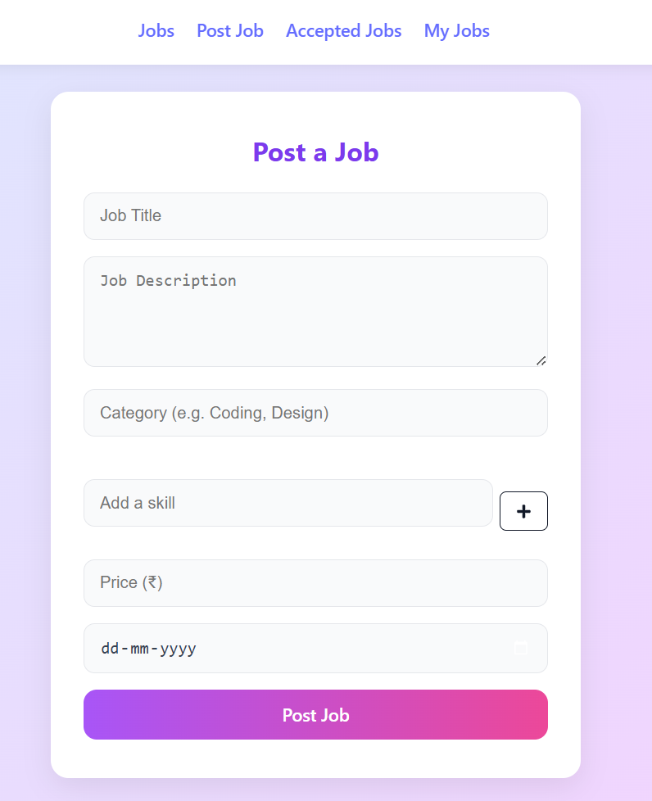
Jobs Pages

Slide 12
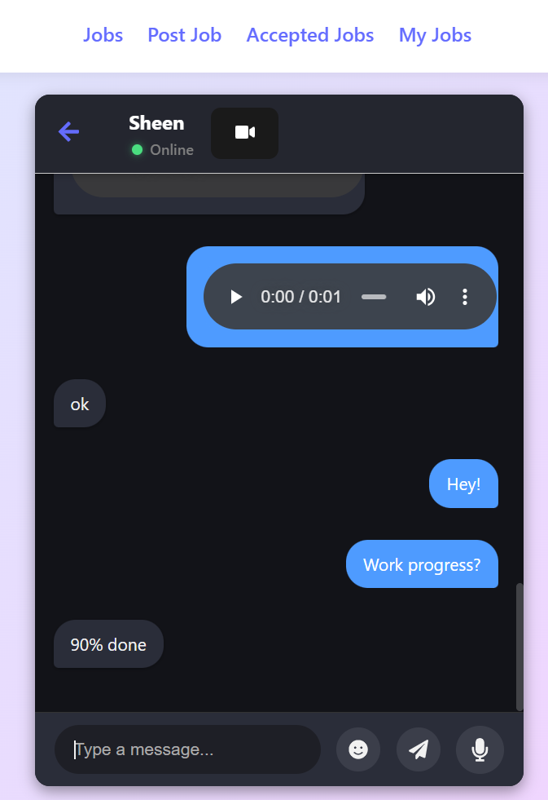
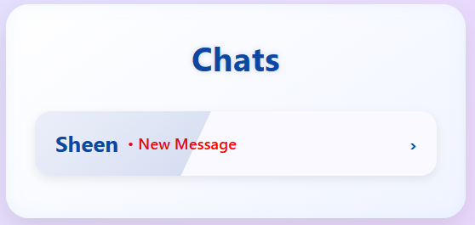
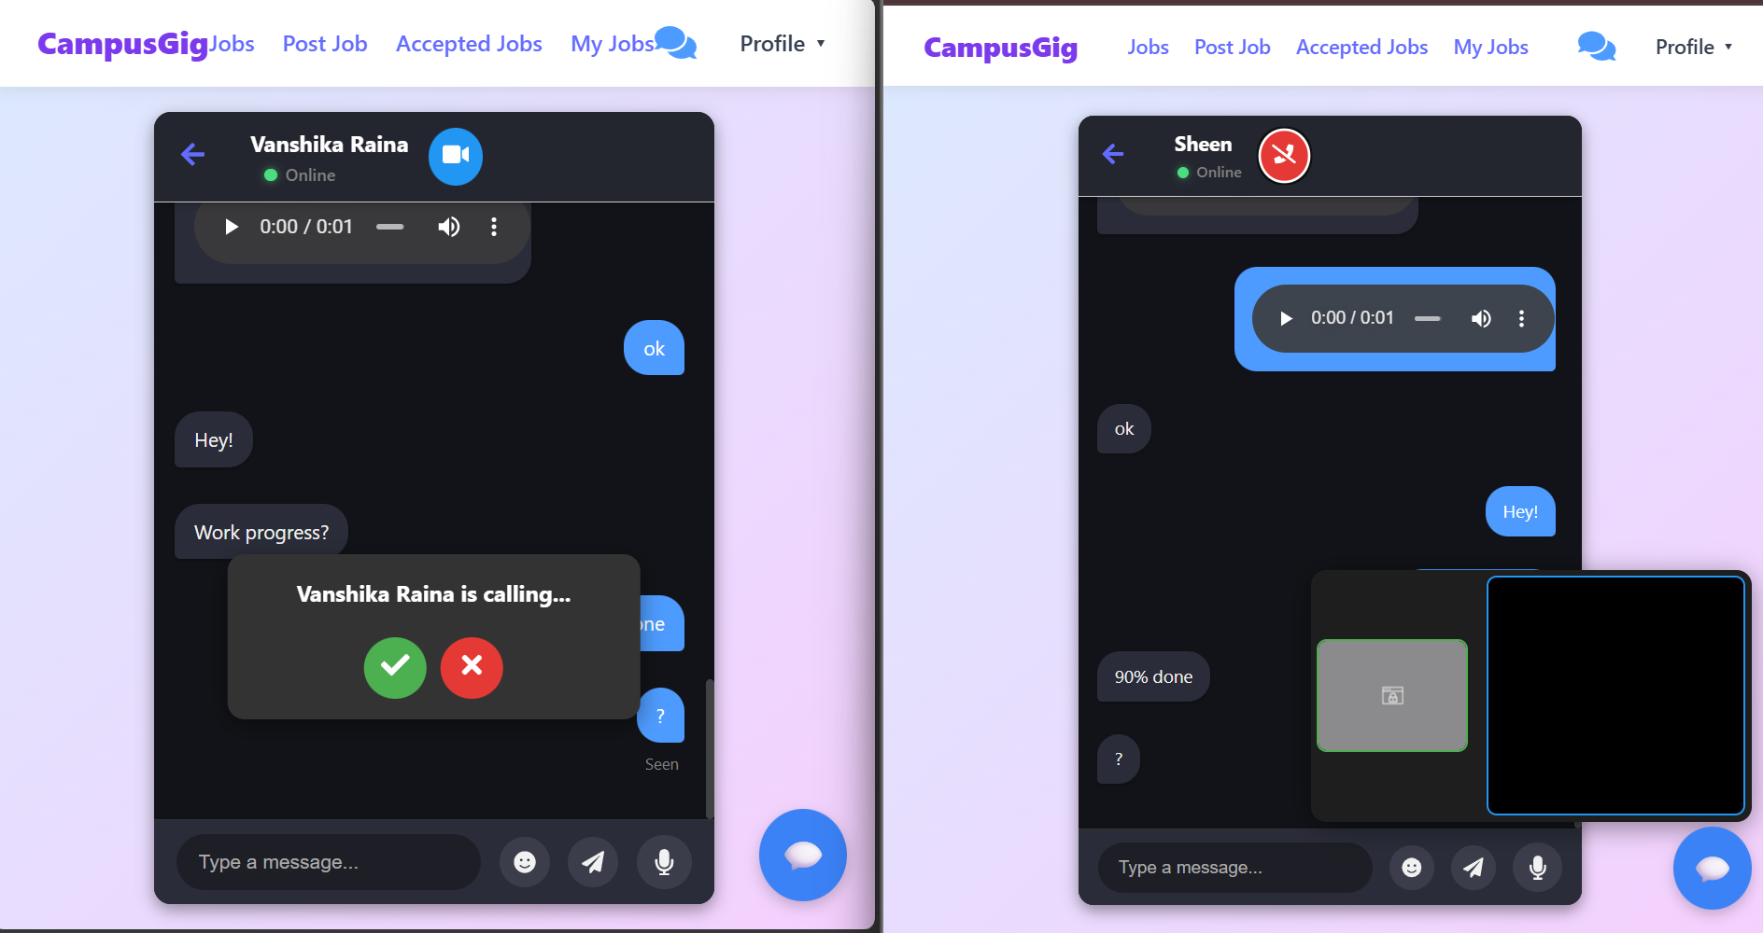
Real Time Chat

Slide 13
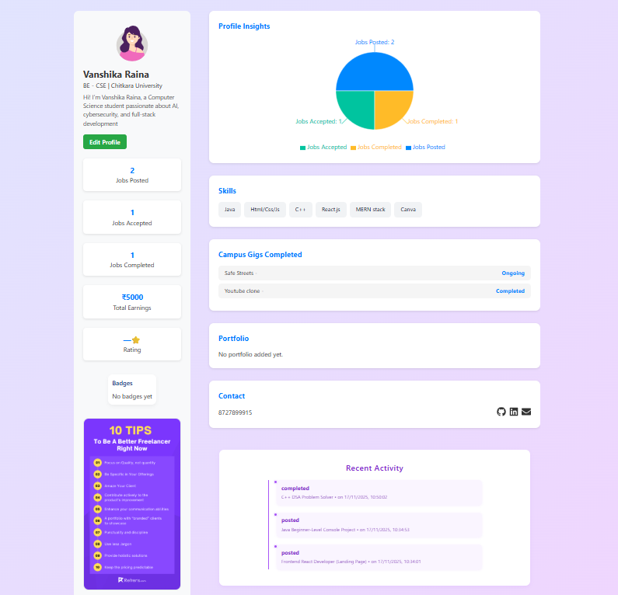
Profile

Slide 14
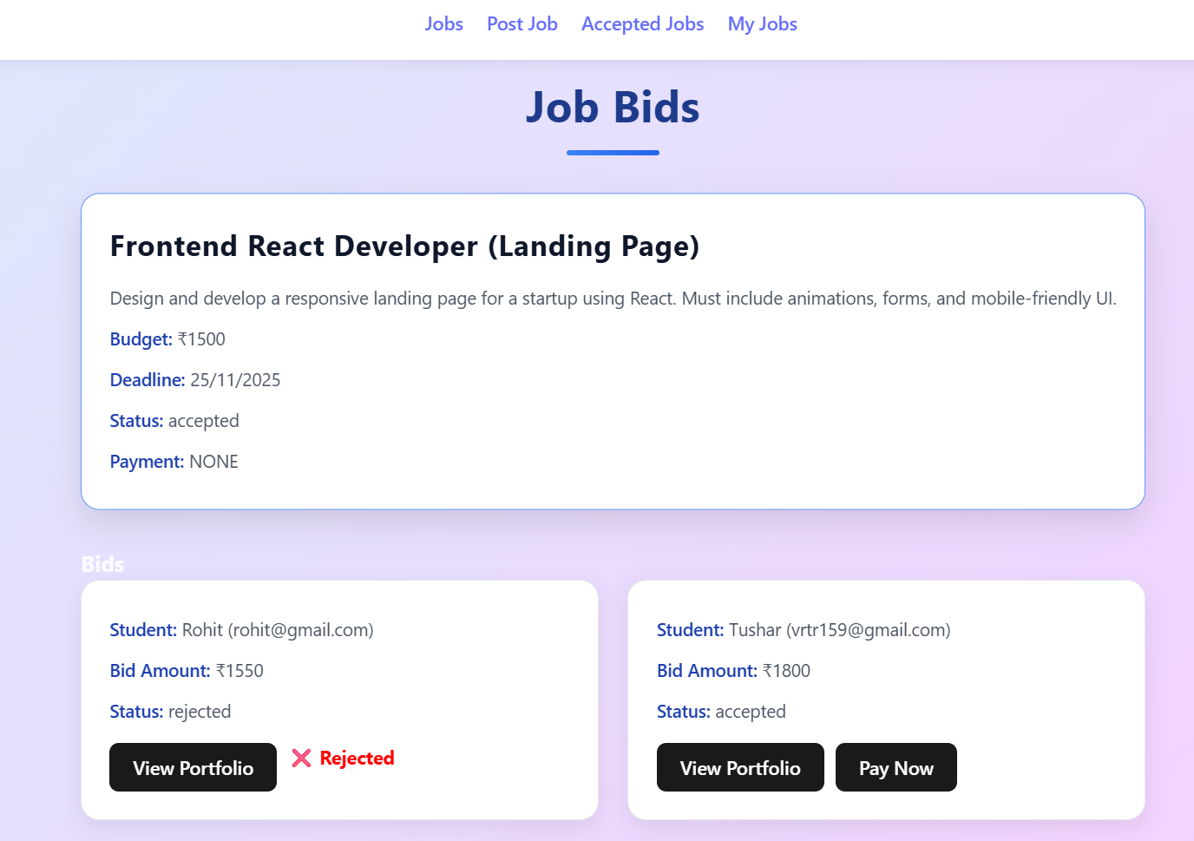
Bidding

Slide 15
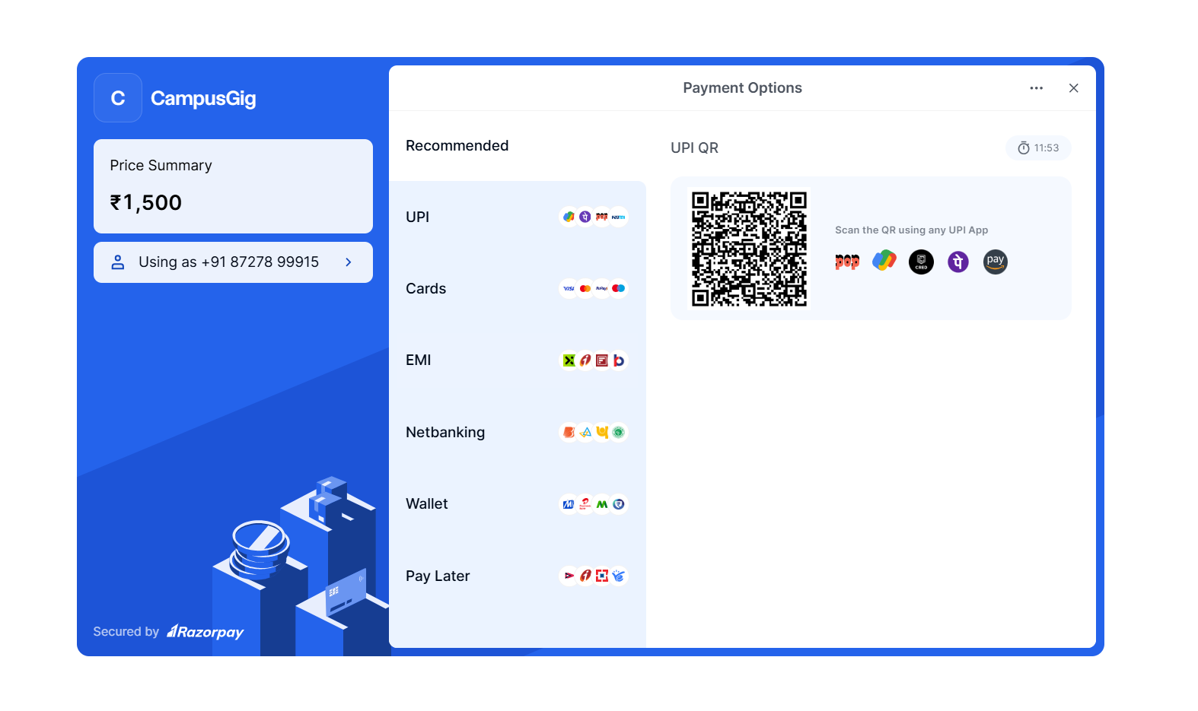
RazorPay Integration

Slide 16
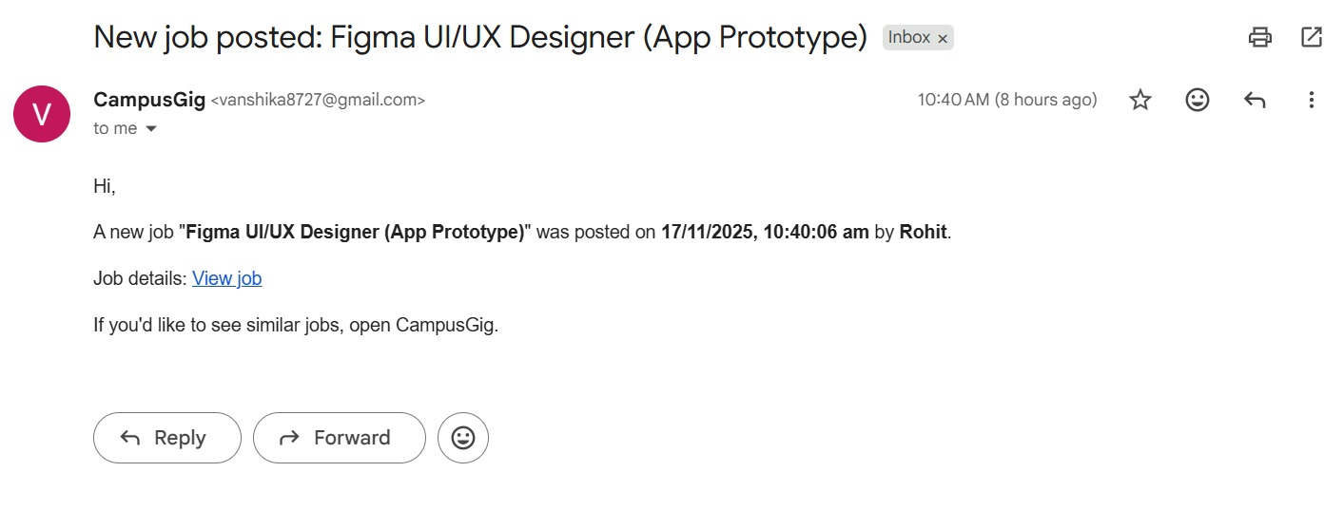
Receiving Mail

Slide 17
FUTURE ENHANCEMENTS
Referral System : Users earn rewards or credits for inviting new members to the platform.
Coupons & Discounts : Special offers to boost engagement, promote services, and increase conversions.
Email/SMS Marketing : Automated messages for new gigs, promotions, reminders, or important platform updates.
Social Sharing : One-click sharing to social media to expand visibility and attract more users.
Verified Reviews : Only clients who completed a gig can post reviews, ensuring authenticity and trust.
Job Approval Workflow : Admin/moderators verify and approve high-value gigs before publishing them live.

Slide 18
CONCLUSION
CampusGig addresses a real need by connecting campus students to gigs in a structured and trustworthy environment.
It improves discoverability, reduces friction, and ensures accountability through user profiles, ratings, and reviews.
It is built on a strong technical foundation using a modern full-stack architecture with modular APIs and a scalable database.
It has room for future enhancements such as real-time chat, secure payments, admin analytics, and intelligent gig matching.
Overall, CampusGig is a scalable and impactful micro-marketplace that can grow, adapt, and support student opportunities effectively.

Slide 19
GITHUB LINK
GitHub repo:
https://github.com/vanshikaraina/_CampusGig GitHub

Slide 20


